Slide 1



The transfer cost of parenthood:
Parents and non-parents in NTA
Robert I. Gal (HDRI, TARKI, CUB)
Marton Medgyesi (TARKI, HAS CSS IS)
Pieter Vanhuysse (SDU)
May 5, 2020
Micro-distributional NTA – Online workshop

Slide 2
Structure of the presentation
We compare the transfer burdens of working age parents and non-parents
We find a major asymmetry between the two groups
We argue that our results are consistent with the frequently demonstrated small fertility effects of social policy: if behavioural effects are limited, redistribution will be large
Finally, we provide some policy conclusions

Slide 3
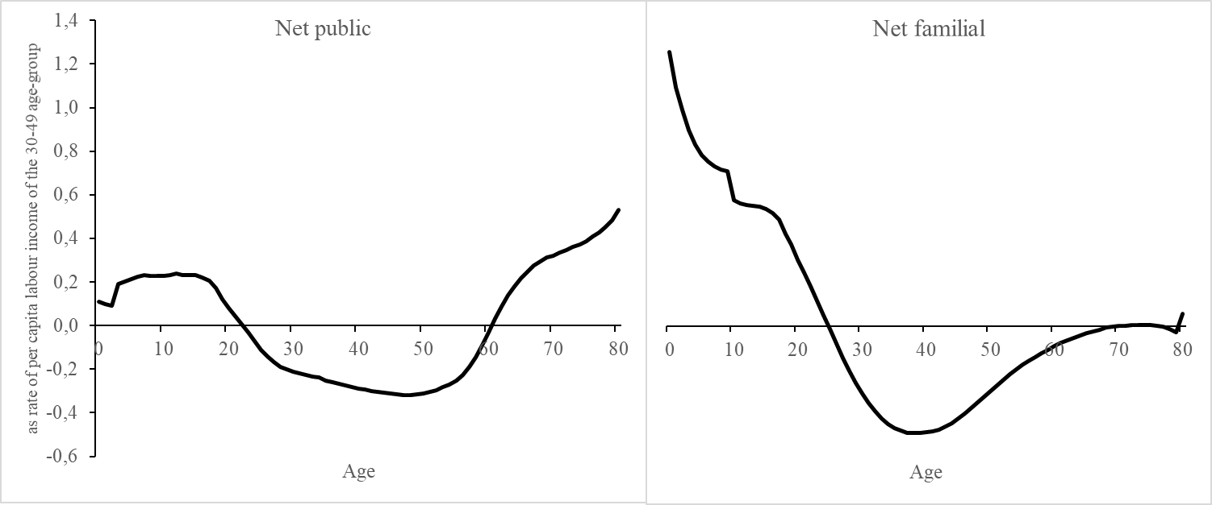
Per capita age profiles of net public and familial transfers in 14 European countries, 2000s
Source: Authors’ computations based on Istenic et al (2016) and Vargha et al (2016).
Note: Familial transfers include both cash and time.

Slide 4
Some notes and observations
Public transfers clearly distinguish between three overlapping age-groups
Familial transfers appear to be almost exclusively two-generational: parents give to children; the balance for older people converges to zero
In effect, older age-groups are absent from the inter-age familial net transfer mechanism
The macro-level analysis makes a strong case: familial transfers are fully parental transfers without the participation of non-parents
However, a strong case is not evidence: many working-age transfers may come from non-parents
Parents and non-parents have to be separated at the micro level

Slide 5
Who is a parent?
In the everyday use of the word parenthood refers to an irreversible status
Once a parent, always a parent
However, child-raising is just a section of the lifecycle
Parenthood never ends but the period of supporting children does
This is in line with the definition of parenthood in the surveys used here; neither EU-SILC, nor HBSs nor EHIS include information on completed fertility
Parenthood is represented by parents who happened to cohabit with children in the base year

Slide 6
Consequences
Cohabitation-based parenthood has no consequences on the separation of public transfers by parenthood status
Child-related benefits are always paid to cohabiting parents
However, there are consequences for familial transfers:
going by this definition, divorced parents and non-cohabiting old parents are not parents
they can provide only inter-household transfers
in contrast, foster parents are parents as long as they choose to be one
parenthood is age-related; its frequency first grows and then decreases by age:
beyond working age there are only small, selected minorities co-residing with their children

Slide 7
Contd.
We cannot distinguish between parental and non-parental inter-household transfers
Inter-household transfers are excluded from the analysis
Co-residing parents beyond working age are excluded
Intra-household transfers have to be split between parents and non-parents living in households with resident child

Slide 8
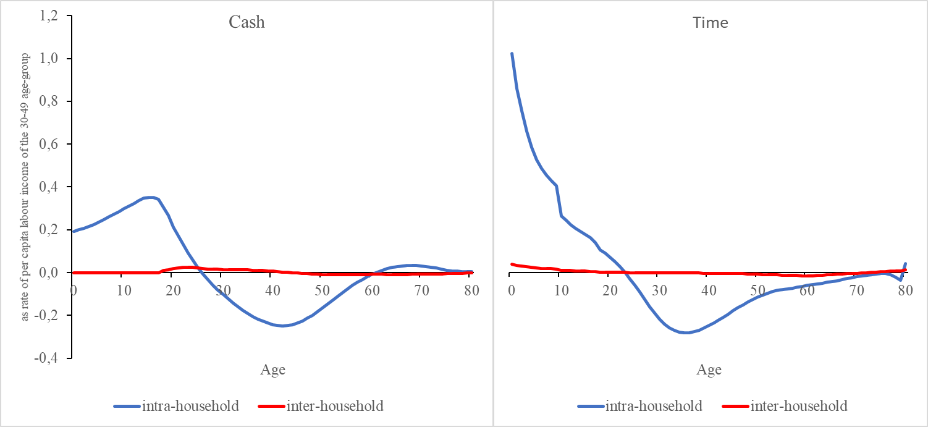
Per capita age profiles of familial transfers split by type (cash vs time) and household boundary (intra-household vs inter-household),
14 European countries, 2000s
Source: Authors’ calculations.
Inter-household transfers are marginal.

Slide 9
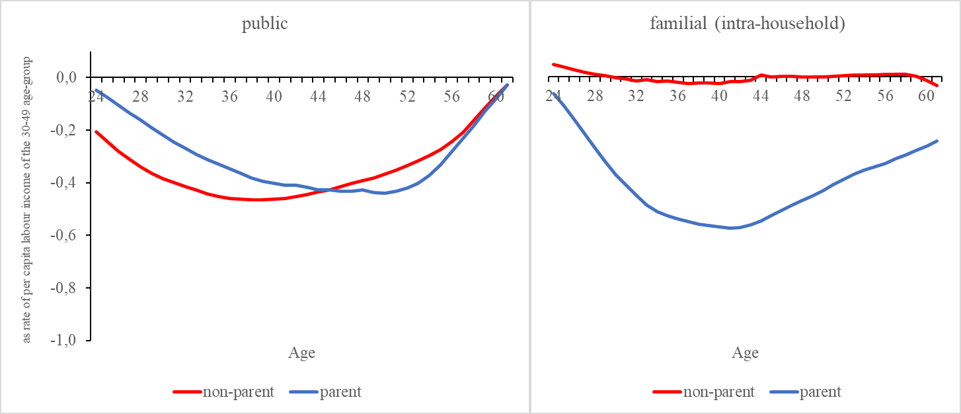
Public and intra-household familial transfers by parenthood status in working age in 14 European countries, 2010
Source: authors’ calculation.
Despite some dissimilarities, the public transfer age-profiles of non-parents and parents are overall not that much different
Familial (intra-household) transfer age-profiles are
Non-parents hardly provide such transfers; parents provide many

Slide 10
The value of the transfer package by parenthood status
Period age-profiles are frequently used to estimate stocks generated over time
Here we compare stylized active ages of parents and non-parents
In this way, we measure the transfer cost of parenthood
Assumptions:
Period age-profiles stand for lifecycle profiles
They are adjusted by growth (g=1.5%), mortality (Eurostat demo-mlifetable_px) and a discount rate (r=5%)

Slide 11
The value of the transfer package in terms of years of prime-earning age labor income by parenthood status by country
 | Non-parents |  |  | Parents |  |  | Parents total / Non-parents total
 | Familial | Public | Total | Familial | Public | Total
Belgium | -0.5 | -8.8 | -9.3 | -7.8 | -7.9 | -15.8 | 1.7
Bulgaria | 0.2 | -7.4 | -7.2 | -6.4 | -6.8 | -13.2 | 1.8
Germany | 0.1 | -7.2 | -7.1 | -8.0 | -5.5 | -13.5 | 1.9
Denmark | -0.1 | -7.3 | -7.4 | -9.2 | -8.5 | -17.7 | 2.4
Estonia | -0.1 | -7.7 | -7.8 | -7.0 | -6.9 | -13.8 | 1.8
Spain | -0.1 | -6.8 | -7.0 | -8.2 | -5.7 | -13.9 | 2.0
Finland | -0.1 | -8.1 | -8.2 | -9.2 | -9.1 | -18.3 | 2.2
France | 0.0 | -8.1 | -8.2 | -8.6 | -6.8 | -15.3 | 1.9
Hungary | -0.3 | -10.7 | -11.0 | -8.8 | -7.1 | -15.9 | 1.5
Lithuania | -0.5 | -8.3 | -8.7 | -6.8 | -8.7 | -15.4 | 1.8
Latvia | -0.9 | -5.4 | -6.3 | -6.5 | -4.7 | -11.2 | 1.8
Poland | -0.2 | -8.2 | -8.4 | -8.7 | -6.6 | -15.3 | 1.8
Sweden | -0.1 | -7.7 | -7.8 | -8.8 | -7.8 | -16.6 | 2.1
UK | 0.0 | -7.5 | -7.4 | -10.7 | -4.5 | -15.2 | 2.0
EU14 | 0.0 | -7.7 | -7.7 | -8.6 | -6.0 | -14.6 | 1.9
Source: authors’ calculation.

Slide 12
Excess transfer burden as a tax on child-raising
Social policies (such as child-related benefits or pensions) are frequently shown to affect fertility
Such effects are usually found to be weak
We argue that the very reason which such effects are weak for is a driver of extensive redistribution
We apply a taxation framework to capture two effects at once:
fertility response and
redistribution by parenthood status

Slide 13
Contd.
Effects of social policies depend on price elasticities:
if demand for children is elastic with respect to the net cost of child raising:
fertility response will be strong
taxes collected (and the resulting redistribution by parenthood status) will be small
if demand is inelastic:
fertility response will be moderate
redistribution from parents to nonparents will be strong (heavy taxes will be collected)
In other words: the very fact that fertility responses to taxing children are small implies that the redistributive effect is large

Slide 14
Conclusions
The overall transfer-burden in working age is almost twice as large on parents than on non-parents in today’s Europe
This asymmetry is not reflected in the eligibility rules of public pension and health care systems
Such circumstances create the conditions of redistribution between parental and non-parental lifecycles
The frequently observed small magnitude of fertility effects of social policy may well go hand in hand with large scale redistribution

Slide 15
Contd.
Taxing price inelastic activities minimise deadweight loss
So, if demand for children is inelastic it would be „efficient” to tax child raising
It is society’s choice to what extent it actually wants to see child raising being taxed
Since parenthood status changes over the lifecycle policy conclusion have to be carefully derived
This paper compared synthetic parents with synthetic non-parents, not actual parents with actual non-parents
One reasonable way to internalise net benefits could be cash or kind compensatory policies, such as child benefits, child care, public education, but also child-related pensions
However, these policies ought not to be seen as pro-natalist but rather as compensatory: a compensation of current anti-natalist policies taxing the activity of child raising
The question is not whether pro-natalist policies are effective but whether they are pro-natalist

Slide 16
See the paper at:
http://ntaccounts.org/doc/repository/CEDA2020%20Gal.pdf
Thank you for your attention!

